Slide 1
STUDENT SUCCESS PREDICTION
NAVYA MOTE

Slide 2
Pre-processing

Slide 3
Dataset: hackathon_els_data_set.csv
Divided file into two parts based on columns
Identified columns with NA’s
Only considered rows that had values for all columns
Converted categorical variables to numeric
Converted all negative values to zero
Removed near zero variance predictors
Removed highly correlated predictors

Slide 4
results

Slide 5
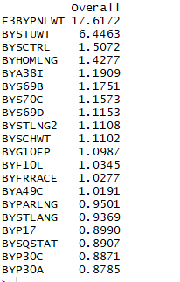
20 most important predictors (dataset-part1)
Examples:
1. Panel weight, BY and F3 (2002 and 2012)
2. Student’s native language-composite
3. Require students to wear uniforms
4. How well 10th grader reads English
5. Whether 10th grader’s mother’s birthplace in US or elsewhere

Slide 6
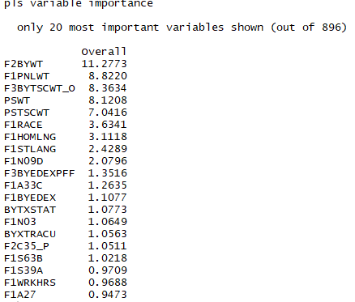
20 most important predictors (dataset-part 2)
Examples:
1. F1 Student’s race/ethnicity-composite
2. How well respondent writes English
3. Number of school-sponsored activities participated in 01-02
4. Volunteered with school/community service organization
5. # of part-time teachers

Slide 7
conclusion

Slide 8
Success Measure : Third follow-up questionnaire respondent weight (A weight for sample members who completed a questionnaire in the third follow-up)
Job satisfaction is based on this variable
What characteristics are indicative that a student may be less successful - How well 10th grader reads English, How well respondent writes English, Whether English is student’s native language-composite, Whether 10th grader’s mother’s birthplace in US or elsewhere, F1 Student’s race/ethnicity-composite, % of full-time teachers are Asian, Volunteered with school/community service organization, How often visits with friends at local hangout, F1 hours worked per week during 03-04 school year to name a few
Present creative ideas or tools for universities – Excel, Tableau, R can be used to observe the correlation, regression, and build charts to help visualize

Slide 9
School can suggest additional coaching for students whose first language is not English
Encourage students to participate in extra curricular activities and volunteering
Cultivate a habit of reading books and pinning down ideas
Speaking English more often
Suggesting parents to speak English at home
Efficient use of time
Demographic and geographic data were redacted in the ELS study data, as were the names of colleges attended – If the dataset had these information, we could have seen if the reputation of school studied, neighborhood had an impact on a student being successful
What redacted variables would you request from this data set – The school names and associated ranking, neighborhood and habits like drinking, smoking if any

